Slide 1
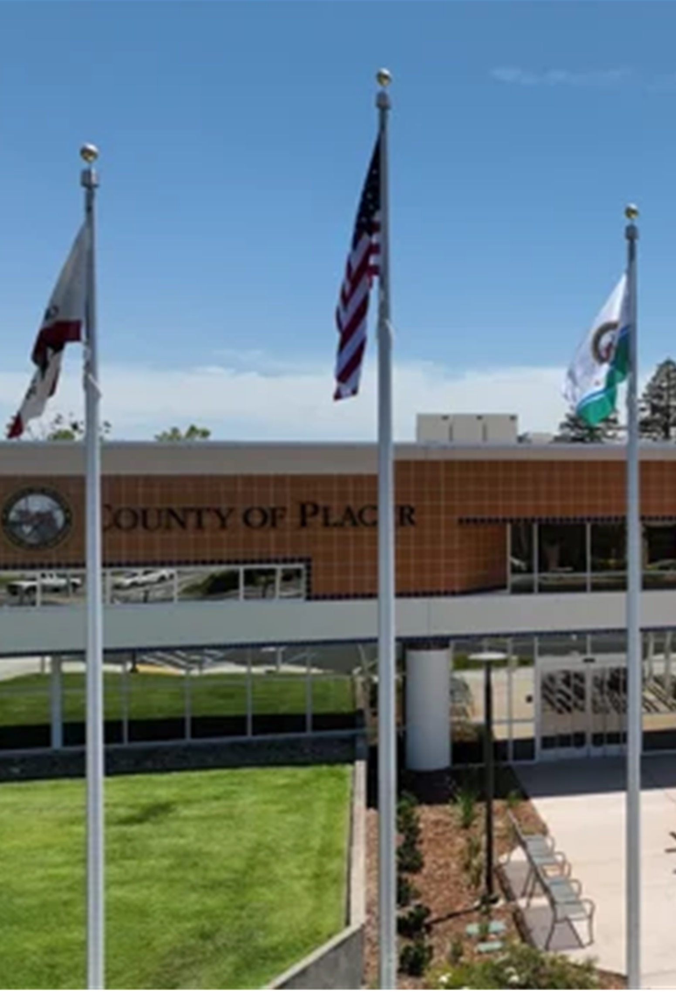
Voting Accessibility Advisory Committee (VAAC)
A forum for representatives of the disability and senior communities to have open discussions about any challenges they face
while voting.

Slide 2
Language Accessibility Advisory Committee (LAAC)
A forum where representatives of voters with diverse language needs have the opportunity to discuss and provide input on language accessibility issues.

Slide 3
Agenda
Elections Staff/Attendee Introductions
Placer Election Administration Plan Update
Poll Observer Feedback
Examining ASL Opportunities
Questions & Answers
Future Agenda Items

Slide 4
Election Administration Plan
Respond in the chat to have Placer email a draft when available.
Alternately, send an email request to election@placer.ca.gov

Slide 5
Observer Feedback
Item to allow for any additional feedback from any observer groups

Slide 6
Examining ASL Opportunities
Placer deploys LanguageLine via smartphone to all Vote Centers and our office
Placer requests input from the community to evaluate what additional services we may be able to provide in the future

Slide 7
June 2, 2026 Gubernatorial Primary Election
Only 425 days until the
Notes:
There are only 553 days until the November General Election…

Slide 8
QUESTIONS AND ANSWERS

Slide 9
FUTURE AGENDA ITEMS
FUTURE MEETINGS / SCHEDULE
Notes:
Next Meeting (Tentative): Thursday, September 5, 2024

Slide 10
THANK YOU

