Slide 1
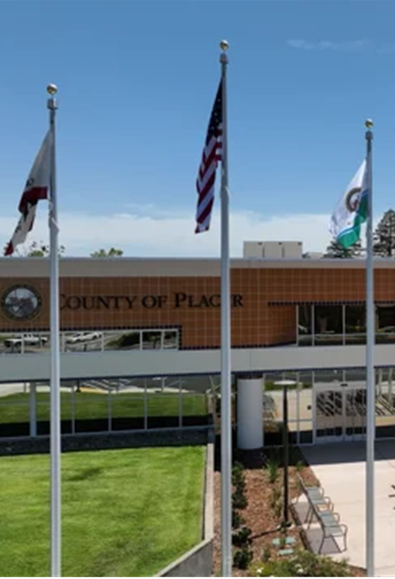
Voting Accessibility Advisory Committee (VAAC)
A forum for representatives of the disability and senior communities to have open discussions about any challenges they face
while voting.

Slide 2
Agenda
  Elections Staff/Attendee Introductions
  March 2024 Presidential Primary Election
      Election Report
      Election Feedback
      Actions Taken
  Questions & Answers
  Future Agenda Items

Slide 3
Placer County
Registration Statistics
  15-day close prior to March 5, 2024 Primary Election
  281,556 Total registered voters
  114,289 40.5% Republicans
  89,229 31.6% Democrats
  54,255 19.2% No Party Preference
Over 8% of voters registered as “other”
Notes:
As of the 15-day close of registration prior to the March Primary Election:
281,556 registered voters in Placer County
41% Republicans 114,289
32% Democrats 89,229
19% No Party Preference 54,255
8% belong to other “qualified” political parties (Green, American Independent, Libertarian, Peace and Freedom)
miscellaneous parties attempting to qualify (Reform Party, Communist Party, etc.)

Slide 4
County Comparison
  California encompasses 58 counties; Placer County is:
  18th largest county in voter registration
  Top 5% of largest counties in the nation
  3rd highest percentage of eligible voters registered in California
  Over 93% of eligible voters registered
Notes:
Out of 58 counties, Placer County is the 18th largest county in voter registration in California.
We are also very close to the top 5% of largest counties in the nation.
We now have the 3rd highest percentage of eligible voters who are registered in California.
Over 93% of our eligible voters are registered.

Slide 5
2024 Presidential Primary Election
Voter Turnout
  135,869 ballots cast
  48.3% of eligible Placer County voters
  Average turnout (presidential primary elections): 55% to 60%
  Placer County higher than California average by 13 percentage points (35%)
  Placer turnout was 16th overall
  In counties our size or larger, only Sonoma County had a higher turnout at 50.2%.
Notes:
This election was historically lower in turnout at a little over 48.3%. Usually in Placer we see a 55% to 60% in a presidential primary election.
Even though turnout was light, we still have higher turnout than most other counties in California.
The state turnout was 35%, so we are beating the state by almost 13 percentage points.
Out of California’s 58 counties, our turnout is currently 16th highest.
Of counties our size or larger, only Sonoma County has a higher turnout at 50.2%.
We attribute our lower-than-average turnout to the fact that the presidential contests were essentially non-contested by the time Super Tuesday rolled around.

Slide 6
2024 Presidential Primary Election
Voter Turnout
  15,295 vote center ballots (including provisionals)
  120,574 vote-by-mail ballots
    8 voters used the RAVBM system
    86 UOCAVA voters also used RAVBM
    104 provisional ballots cast; 85% qualified to be counted
    446 CVR ballots cast; 97% qualified to be counted
    Crossover ballot requests:
    2,845 Democratic/NPP
    707 American Independent/NPP
    133 Libertarian/NPP
Notes:
Our turnout was 48.3%, with almost 135,869 ballots cast:
15,295 vote center ballots (including provisions)
120,574 vote-by-mail ballots
8 voters that used RAVBM.
86 UOCAVA voters used RAVBM.
104 provisional ballots were cast; more than 85% of them were qualified to be counted.
446 CVR ballots were cast; more than 97% were qualified to be counted.
For this presidential election the Democratic, American Independent, and Libertarian parties were allowing crossover voting;
2,845 Democratic/NPP requested ballots
707 American Independent/NPP requested ballots
133 Libertarian/NPP requested ballots

Slide 7
Election
Report
In-person
Voting
4,000 voted during 10-day early voting period
11,000 voted on Election Day
6,300 voters cast polling place ballots
Over 8,000 scanned their vote-by-mail ballots (AB 626)
Notes:
4,000 voters voted early in the first 10 days before Election Day and around 11,000 waited until Election Day to vote
6,300 voters cast their ballots as traditional polling place ballots
Over 8,000 scanned their vote-by-mail ballots at the vote center and watched their ballots being counted right there in real time. Part of this was because we asked our vote center staff to encourage voters to scan their ballots in this manner

Slide 8
Election
Report
Most popular vote center overall:
    Rocklin Clerk-Recorder-Elections Office
    1,247 voters over 11 days
Busiest vote center on Election Day:
    Granite Bay Library
    718 ballots cast
In-person voting increased 8% to 11%
9 out of 10 votes cast used a VBM ballot:
    By mail
    By drop box
    At a vote center
Notes:
Our most popular vote center was at our new Rocklin office with 1,247 voters over 11 days
The busiest vote center on Election Day was the Granite Bay Library location with 718 voters casting ballots at this location
By encouraging voters to scan and count vote-by-mail ballots at the vote centers, we increased our in-person voting participation from 8% to around 11%. While there was an increase in our in-person voting, that means that roughly 9 out of 10 voters were not in person and either mailed their ballot back, placed their ballot in one of the 30 ballot drop boxes or took their ballot to a vote center and dropped it off in that chosen location

Slide 9
Drop Box
Utilization
30 Placer County drop boxes
Highest number of returned ballots:
9,494 Placer County Clerk-Recorder Office – Auburn
Lowest number of returned ballots:
133 Olympic Valley Public Utility District
Drop boxes specifically requested by VAAC and LAAC:
347 Gurdwara Sahib Sikh Temple
825 Oriental Market
Adding a 24/7 drop box at the Tahoe Truckee Airport for the November general election.
Notes:
Placer County had 30 drop boxes located throughout the county.
Highest number of returned ballots:
9,494 Placer County Clerk-Recorder Office – Auburn
Lowest number of returned ballots:
133 Olympic Valley Public Utility District
Requested boxes specifically from LAAC and/or VAAC meetings:
347 Gurdwara Sahib Sikh Temple
825 Oriental Market
At the request of Truckee residents to add a drop box, we are working with the Tahoe Truckee Airport District to add a 24/7 drop box. The drop box should be operational by the November general election.

Slide 10
Canvass
Period
  69,436 ballots examined
  2,708 challenged for non-matching or missing signatures
  Outreach to voters was conducted by:
    Mail
    Phone
    email
  2,441 (90%) were cured and qualified
  Postelection functions performed:
    Reconciling voter rosters
    1% manual tally
  Placer hand counted:
    6,062 vote center ballots
    1,401 vote-by-mail ballots
Notes:
We carried 69,436 ballots into the canvass period.
There were 2,708 ballots that were challenged for non-matching or missing signatures. After the office reached out to voters by mail, phone, and email to cure them 2,441 were cured and qualified, accounting for a 90% cure rate.
We perform two very important postelection functions during the canvass period:
We reconcile our voter rosters, which checks to make sure our volunteers didn’t stuff the ballot box at the vote centers.
And we performed a manual tally – auditing our machine count to make sure our IT staff programmed the machines correctly and nobody corrupted the machines out at the vote centers.
6,062 vote center
1,401 vote-by-mail

Slide 11
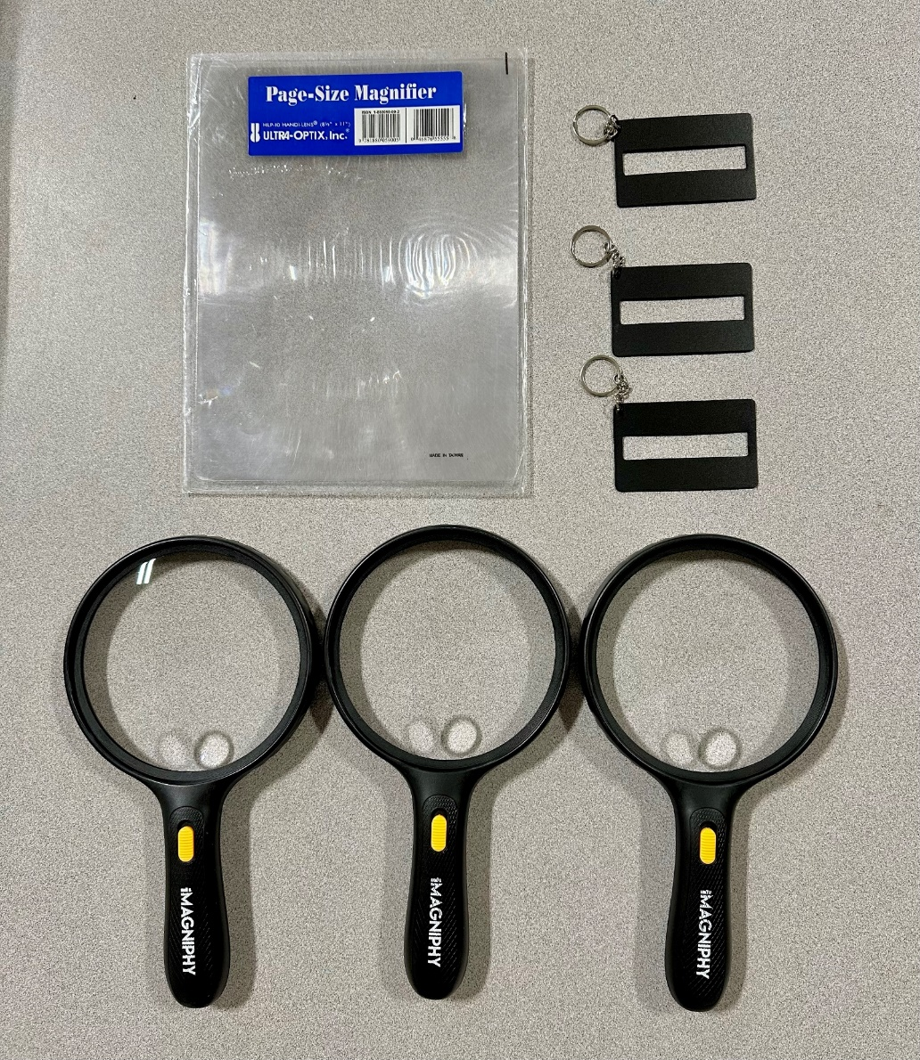
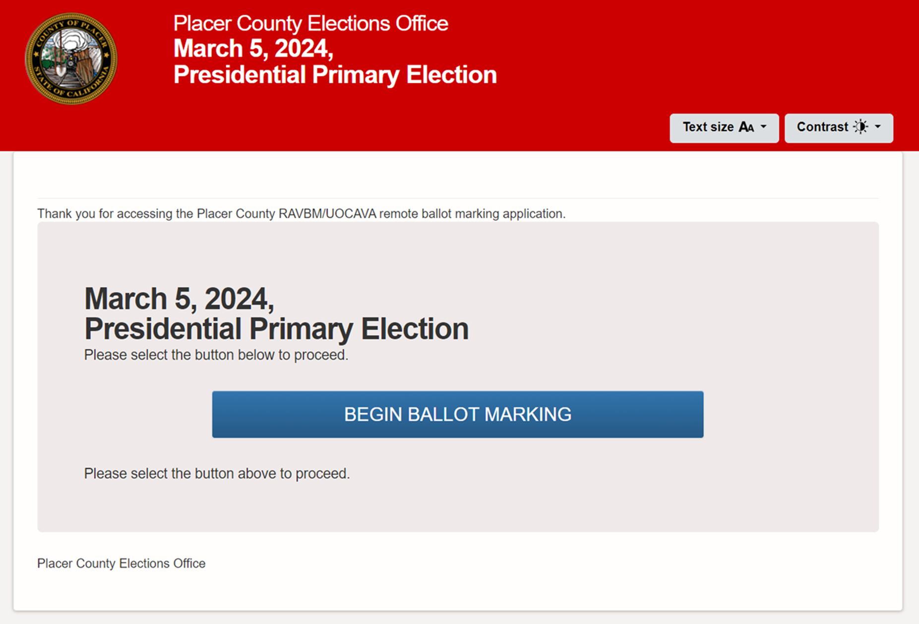
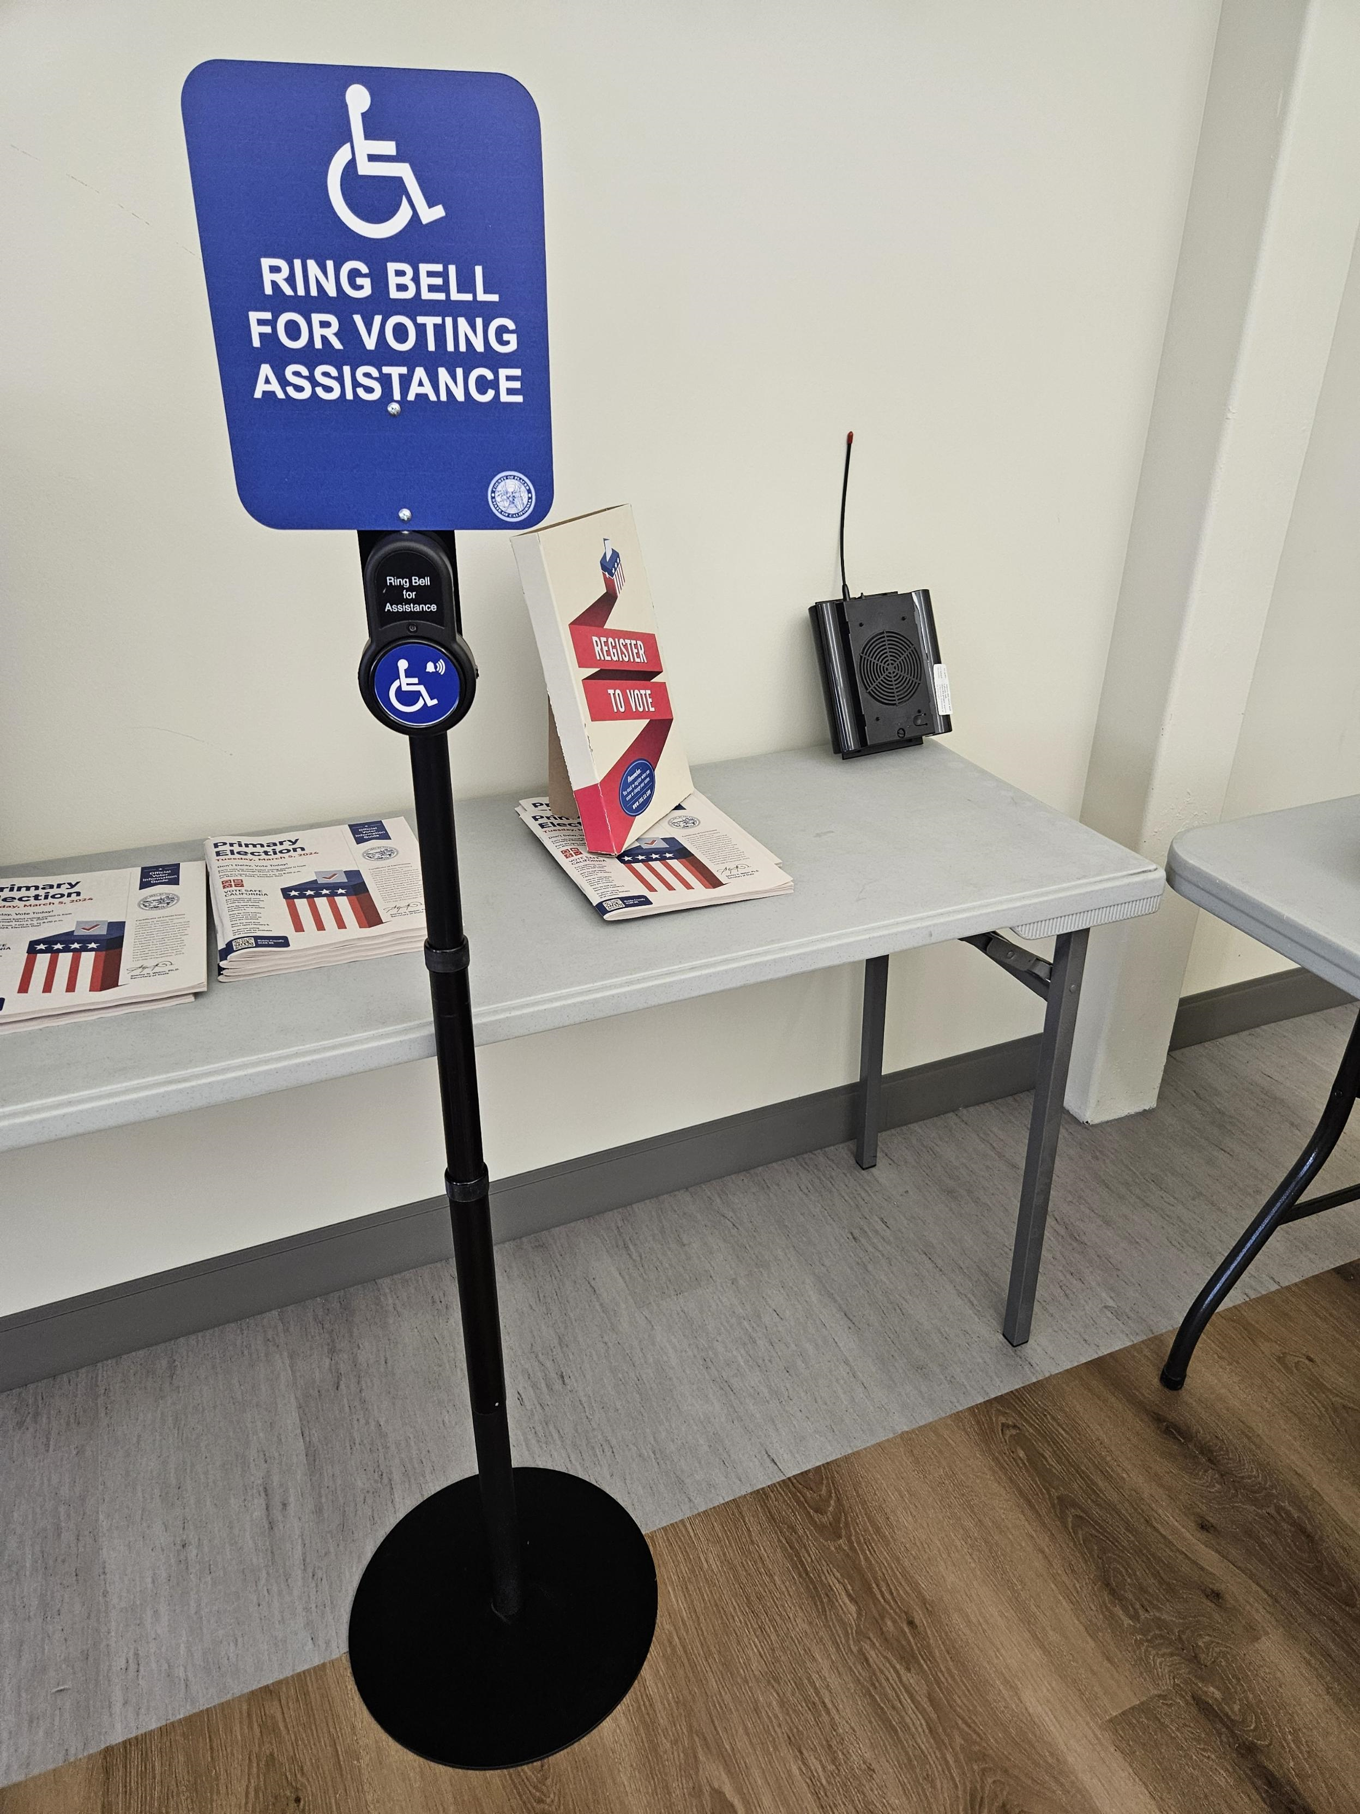
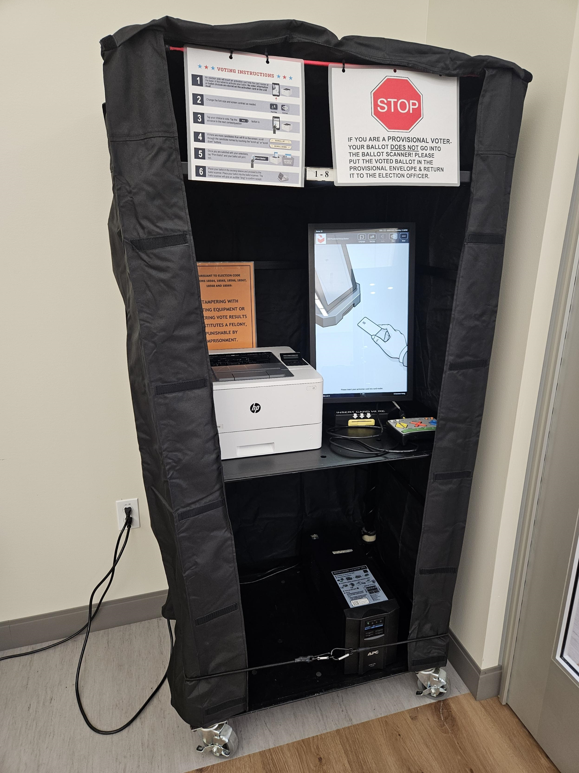
Accessible Voting Tools and Resources

Slide 12
Vote
Centers

Slide 13
Drop
Boxes

Slide 14
Voter Information Guide

Slide 15
Voter Information Guide
Accessibility RAVBM Page

Slide 16
VCA
Postcard #1

Slide 17
VCA
Postcard #2

Slide 18
Public Workshop(s)

Slide 19


Election
Feedback
Some materials not readily available or easily viewed
Assistive devices not readily observed
Improved informational signage
Additional directional signage
Vote center workers not easily identifiable
Notes:
Following the March 2024 primary election, our office received valuable feedback from a number of poll observers and groups. These comments and suggestions have been carefully considered and, where possible, will be incorporated into our future training and vote center organization.
Some materials not being readily available or easily viewed by voters when entering a vote center
Assistive devices not readily observed but still available upon request
Insufficient informational signage in the vote center
Insufficient directional signage to and around the vote center
Vote center workers not easily identifiable by wearing a nametags

Slide 20
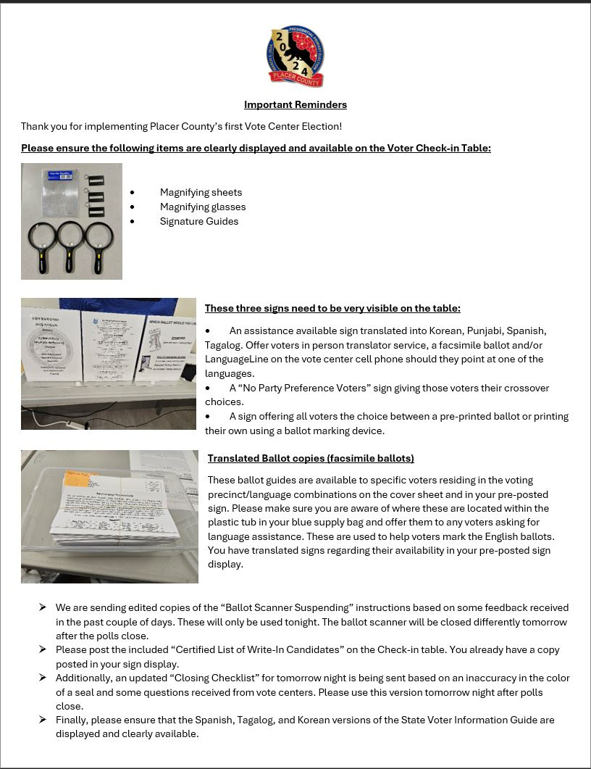
Actions
Taken
Notes:
A reminder notice was sent to all vote centers after DRC’s initial feedback.

Slide 21
Actions
Taken
Incorporated into updated election aide training manual and syllabus
Reinforced during election aide training
Ground staff at vote centers
Notes:
These concerns and the other information that was received will be incorporated into the updated election aide training manual and syllabus as well as being reinforced during election aide training.
In the first few days of the November election, our on the ground staff will be in the vote centers to review the vote center, and to make suggestions and corrections to vote center devices and materials.

Slide 22
November 5, 2024
General Election
  Only 152 days until the November general election
Notes:
There are only 152 days until the November General Election…

Slide 23
QUESTIONS AND ANSWERS

Slide 24
FUTURE AGENDA ITEMS
FUTURE MEETINGS / SCHEDULE
Notes:
Next Meeting (Tentative): Thursday, September 5, 2024

Slide 25
Thank You

